Slide 1
Link Layer
Provides reliable transmission of data frames between two nodes connected at the physical layer
Divides into 2 sub-layer functions
  Media Access Control
    responsible for controlling how devices in a network gain access to a medium and permission to transmit data
  Logical Link Control
    responsible for identifying and encapsulating network layer protocols, and controls error checking and frame synchronization.

Slide 2
Link Layer
  Point to point data transfer occurs from one MAC layer to another
WAN encapsulation of frames at Data Link layer involves one or more of the following services
  Addressing
  Bit-level integrity check
  Delimitation
  Protocol identification (PID)

Slide 3
Link Layer
  Point

Slide 4
Link Layer
Frame formats support variable length frame sizing
Represents same data that appears in digital form at the Network layer in an IP datagram
CSMA/CD or Carrier sense, Multiple Access with Collision Detection allows numerous systems to send data over the network interface most likely Ethernet
Wireless Wi-Fi and Ethernet are similar in frame format

Slide 5
Link Layer
Ethernet II frame type
  De facto standard frame type used for IP datagram transmissions over Ethernet networks
  Has protocol identification field
Ethernet frame types that TCP/IP can use
  Ethernet II
  Ethernet 802.2 Logical Link Control

Slide 6
Link Layer
Ethernet II frame type fields and structure
  Preamble
  Destination Address Field
  Source Address Field
  Type Field
  Data Field
  Frame Check Sequence Field

Slide 7
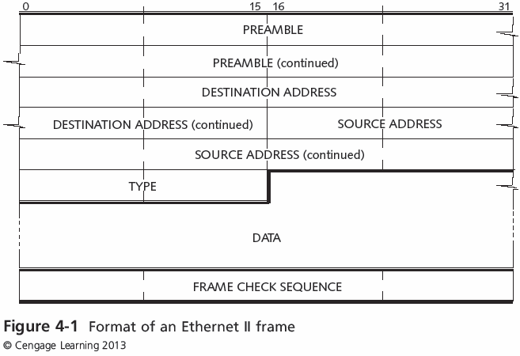
Link Layer

Slide 8
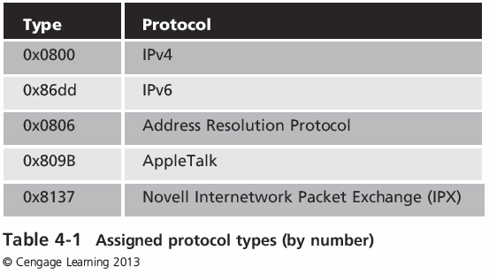
Link Layer
Ethernet II Frame Structure

Slide 9
Link Layer
Full Duplex - communication between two components means that both can transmit and receive information between each other simultaneously
Duplex mismatch can cause a slowdown but not necessarily a complete shutdown of communication

Slide 10
Link Layer
Bridges and switched learn addresses by each other over time.
  When first turned on a switch or bridge has an address database that is empty!
  It receives frames and learns the addresses on the network

Slide 11
Link Layer
Spanning Tree Protocol is an important protocol because there may be numerous nodes on a network.
The STP is used to prevent signals from bouncing back and forth between nodes

Slide 12
Link Layer
Wireless Fidelity or 802.11 is a wireless Ethernet!
  Acceptable performance
  Inexpensive
  Easily set
  FCC allows channels and frequencies to use

Slide 13
Link Layer
Wireless also allows for Power over Ethernet (PoE)
  No need for local power supply
  Security:
  WEP : Wired Equivalent
  WPA : Wi-Fi Protected Area
  TKIP : Temporal Key Integrity Protocol

Slide 14
Link Layer
Wireless can work in a mesh configuration.
  Each node is able to connect with all the other nodes
  In the Link layer the use of a MTU ( Maximum Transmission Unit) allows communication to proceed without major issues.

Slide 15
Link Layer
Tunneling: Carrying lower layer traffic in a higher layer
A VPN (Virtual Private Network) utilizes this process
  GRE – Generic Routing Encapsulation
  L2TP – Layer 2 Tunneling protocol MS proprietary protocol)
  PPTP – Point to Point Tunneling Protocol

